Slide 1
305.1 - Introduction to Maven Build Tool

Slide 2
Learning Objectives:
In this lesson, we will discover how to use and install Maven and how to use Maven in Java.
By the end of this presentation, learners will be able to:
Demonstrate the setup of Maven on local machine.
Describe the Core Concepts of Maven.
Explore Maven’s ability to describe, build, and manage Java software projects using the Project Object Model (POM) in XML.
Identify the maven Dependencies and Repositories
Introduction to the
Maven Build Tool

Slide 3
Table of Contents
Introduction to Maven.
Advantages of Using Maven.
Core Concepts of Maven.
Installation of Maven.
Overview of Project Object Model.
Sample for pom.xml File.
Maven Build Lifecycle.
Overview of Dependencies and Repositories.
Search for Dependencies.
Maven Plugins.
How Maven Works.

Slide 4
Introduction to Maven
Maven is a Java-based tool. The Apache Group developed Maven to support the development and building of multiple projects together for publishing and deploying multiple projects and generating the reports.
Maven aims to describe two important things:
How a software is built.
The dependencies (jar files), plug-ins, and profiles that the project is associated with in a standalone or distributed environment.
A more formal definition of Apache Maven is “a project management tool, which encompasses a project object model, a set of standards, a project lifecycle, a dependency management system, and the logic for executing plugin goals at defined phases in a lifecycle.”
When you use Maven, you describe your project using a well-defined project object model (POM). Maven can apply cross-cutting logic from a set of shared (or custom) plugins.
Notes:
"Maven, a Yiddish word meaning accumulator of knowledge,

Slide 5
Advantages of Using Maven
Dependencies.
Convention over configuration.
Multiple/repeated builds.
Automation.
Plugin management.
Testing.
Development process.
Build status.
Consistent setups.
Standard and uniformed directory structure.

Slide 6
Core Concepts of Maven
Project Object Model (POM) Files: When you execute a Maven command, you give Maven a POM file to execute the commands on.
Dependencies and Repositories: Dependencies are external JAR files (Java libraries) that your project uses.
Build LifeCycles, Phases, and Goals: A build lifecycle consists of a sequence of build phases, and each build phase consists of a sequence of goals.
Profiles: Build profiles are used if you need to build your project in different ways. For instance, you may need to build your project for your local computer for development and testing. You may also need to build it for deployment on your production environment. These two builds may be different. To enable different builds, you can add different build profiles to your POM files. When executing Maven, you can tell which build profile to use.
Plugins: Build plugins are used to insert extra goals into a build phase. If you need to perform a set of actions for your project, which are not covered by the standard Maven build phases and goals, you can add a plugin to the POM file. Maven has some standard plugins you can use, and you can also implement your own in Java.

Slide 7
Installation of Maven
Verify that your system has JDK installed. If it does not, install Java.
Check that the Java Environment variable is set. If it is not, set the Java Environment variable using this link: install java and setting environment variable.
Download Maven. Click here → (Link).
Unpack your Maven zip at any place in your system (folder).
Adding Maven to the Environment variable (system variable environment and PATH environment variable).
We add both M2_HOME and MAVEN_HOME variables to the Windows environment.
Open cmd and run mvn -v command.

Slide 8
Guided Lab - Installation of Maven
Find the GLAB - 305.1.1 - Installing Maven on Windows on Canvas under the Assignments section.

Slide 9
Overview of Project Object Model
Project Object Model (POM) in Maven is a core element. Maven projects consist of one configurable file called pom.xml. The pom.xml will always be located in the root directory of any Maven project, and the file represents the very basic and fundamental unit in Maven.
The pom.xml contains the information related to the project, which is built in. It contains all of the necessary information about the configuration details and the dependencies and plugins included in the project. In simple words, it contains the details of the build lifecycle of a project.
Maven provides six scopes: compile, provide, runtime, test, system, and import.
Notes:
Project Object Model (POM) refers to the XML files with all the information regarding project and configuration details
It contains the project description, as well as details regarding the versioning and configuration management of the project
The XML file is in the project home directory. Maven searches for the POM in the current directory when any given task needs to be executed

Slide 10
Overview of Project Object Model (continued)
Maven scans through the entries of the pom.xml file. This will enable Maven to read all of the configurations made, and build profiles defined, repositories configured, and all other important details, and then execute the tasks accordingly.
Configurations in the pom.xml file:
Dependencies used in the projects (Jar files).
Plugins used (report plugin).
Project versions.
Developers involved in the project.
Mailing lists.
Reporting.
Build profiles.
Notes:
Project Object Model (POM) refers to the XML files with all the information regarding project and configuration details
It contains the project description, as well as details regarding the versioning and configuration management of the project
The XML file is in the project home directory. Maven searches for the POM in the current directory when any given task needs to be executed

Slide 11
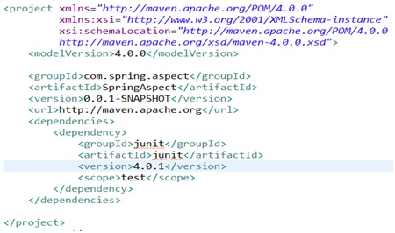
Sample for Pom.xml File
A pom.xml will always start with the root element called <project> under which all of the other required configurations (see below) will be made:
project - the root element of the pom.xml file.
modelVersion - the version of the POM model you are using.
groupId - a project id, uniquely identifying your project across all projects.
artifactId - defines the name of any project. The jar without a version. If you created it, you can choose whatever name you want with lowercase letters and no strange symbols.
version - used to derive the version of any project in order to classify the versions and used when the major changes/implementations are carried during the development phase of a project.
The groupId, artifactId, and version tag combine to form the unique identifier, and are the mechanism by which you specify which versions of external libraries (e.g. JARs) your project will use.
Developers should ensure to define the list of elements which are known as Maven coordinates before defining a pom.xml file.
Notes:
Reference:https://maven.apache.org/guides/introduction/introduction-to-the-pom.html

Slide 12
Sample for Pom.xml File (continued)
Dependencies - elements used to define a list of dependencies of a project.
Dependency - defines a dependency, and is used inside a dependencies tag; described by its groupId, artifactId, and version.
Scope - attribute used to specify the visibility of a dependency, relative to the different lifecycle phases (build, test, runtime etc). Maven provides six scopes: compile, provide, runtime, test, system, and import.
Packaging - used to package the project to output types such as JAR, WAR, etc.

Slide 13
Maven Build Lifecycle
The sequence of steps defined in order to execute the tasks and goals of any Maven project is known as build lifecycle in Maven.
Developers only need to learn a small set of commands to build any Maven project, and the POM will ensure that they get the results desired.
Maven comes with three built-in build lifecycles:
Clean - this phase involves cleaning of the project (for a fresh build and deployment).
Default - this phase handles the complete deployment of the project.
Site - this phase handles generating the Java documentation of the project.

Slide 14
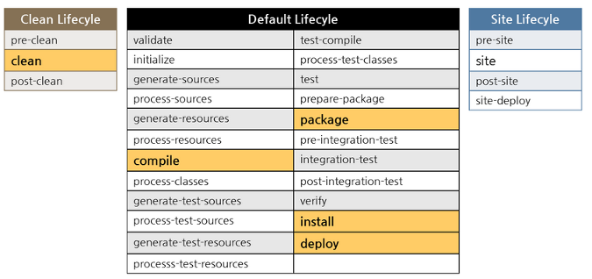
Maven Build Lifecycle (continued)
The default lifecycle is the primary cycle that is responsible for building the application. There are 21 different phases in the primary lifecycle, beginning with the process of validation and ending with the step of deployment.
image src: StackOverflow.com

Slide 15
Overview of Dependencies and Repositories
Dependencies are external Java libraries required for the project, and repositories are directories of packaged JAR files. The local repository is just a directory on your machine’s hard drive. If the dependencies are not found in the local Maven repository, Maven will download them from a central Maven repository and put them in your local repository.
To download the required artifacts of the build and dependencies (JAR files) and other plugins, which are configured as part of any project, there should be a common place where all such artifacts are placed. This commonly shared area is called a Repository.
In Maven, repositories are classified into three main categories:
Local Repository.
Remote Repository.
Central Repository.

Slide 16
Local Repository
The local repository resides in our local machine, which is cached from the remote/central repository downloads, and is ready for the usage.
The folder to hold/place all of the dependencies in the local repository can be configured in the settings.xml file of the Maven folder under the tag <localRepository>.
The default location of the local repository is $HOME/.m2/repository.
<settings xmlns="http://maven.apache.org/SETTINGS/1.0.0"
xmlns:xsi="http://www.w3.org/2001/XMLSchema-instance"
xsi:schemaLocation="http://maven.apache.org/SETTINGS/1.0.0 http://maven.apache.org/xsd/settings-1.0.0.xsd">
<localRepository>D:/m2repo</localRepository>
</settings>

Slide 17
Remote Repository
The remote repository, as the name suggests, resides in the remote server and can be accessed by using different file transfer protocols such as file:// or http://. Remote repositories will be used for both downloading and uploading the dependencies and artifacts.
<repositories>
<repository>
<id>remote.repository</id> <url>http://download.ogrname.com/maven2/</url>
</repository>
</repositories>

Slide 18
Central Repository
The central repository is provided by the Maven community. This repository contains large sets of commonly used/required libraries for any Java project. Basically, internet connection is required if developers want to make use of this central repository; but no configuration is required for accessing this central repository.
<repositories>
<repository>
<id>central.repository</id> <url>http://repo1.maven.org/maven2/</url>
</repository>
</repositories>

Slide 19
Search for Dependencies
When Maven starts executing the building commands, it starts searching the dependencies as explained below:
It scans through the local repositories for all of the configured dependencies. If found, it continues with further execution. If the configured dependencies are not found in the local repository, then it scans through the central repository.
If the specified dependencies are found in the central repository, those dependencies are downloaded to the local repository for future reference and usage. If not found, Maven starts scanning into the remote repositories.
If no remote repository has been configured, Maven will throw an exception saying, ‟not able to find the dependencies,” and stops processing. If found, those dependencies are downloaded to the local repository for future reference and usage.
Notes:
configured remote repo is searched for before central repo.

Slide 20
Maven Plugins
Maven is actually a plugin execution framework, where every task is performed by plugins used to:
Create jar files.
Create war files.
Compile code files.
Test units of code.
Create project documentation.
Create project reports.
A plugin generally provides a set of goals, which can be executed using the following syntax:
mvn [plugin-name]:[goal-name]
Example: A Java project can be compiled with the maven-compiler-plugin-compile-goal by running the following command:
mvn compiler:compile
Notes:
Common plugins:
Clean
Compiler
Surefire
Jar
War
Javadoc
Antrun

Slide 21
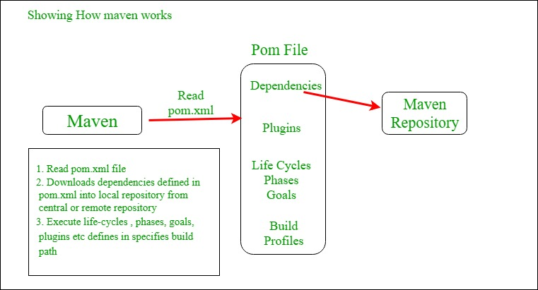
How Maven Works
img src: geeksforgeeks.org

Slide 22
Check Your Knowledge
What is Maven?
What is POM?
What is Clean, Default, and Site in Maven?
What is a Maven Repository?
What are the different types of Maven Repositories?
What is a Maven Artifact?

Slide 23
Summary
In this lesson, we explored the Maven Build Tool. Maven simplifies and standardizes the project build process. It handles compilation, distribution, documentation, team collaboration, and other tasks seamlessly.
Maven increases reusability and takes care of most of build-related tasks. It helps in bypassing steps like adding jars to the project library, building reports, executing Junits test cases, and creating Jar and War Ear files for the project deployment, and many other steps.
To configure the Maven, you need to use Project Object Model, which is stored in a pom.xml-file.
In the context of Maven, a dependency is simply a JAR file used by a Java application. Based on the POM file, Maven will download and add the JAR file to our Java path. Java will then be able to find and use the classes in the JAR file
There are exactly two types of repositories: local and remote:
The local repository is a directory on the computer where Maven runs. It caches remote downloads and contains temporary build artifacts that you have not yet released.
The remote repositories refer to any other type of repository, accessed by a variety of protocols such as file:// and https://.

Slide 24
References
Apache Maven Project - Introduction.
Introducing Maven.
https://www.simplilearn.com/tutorials/maven-tutorial/maven-interview-questions.
https://www.javawebtutor.com/articles/maven/maven_repositories.php.
https://blogs.oracle.com/developers/post/mastering-maven-dependency-basics

